Slide 1

GL BAJAJ INSTITUTE OF TECHNOLOGY AND MANAGEMENT GREATER NOIDA
A PROJECT PRESENTATION ON:
BANKING SYSTEM
(2020-2021)
SUBMITTED TO:
MRS.PAYAL GARG
DEPARTMENT OF COMPUTER SCIENCE
AND ENGINEERING
PRESENTED BY:
DEVESH KUMAR SINGH (1819210099 CSE 3B)
DIWAKAR SINGH (1819210108 CSE 3B)

Slide 2
CONTENT
1.INTRODUCTION
2.AIM
3.PUPOSE
4.WORKING OVERVIEW
5.FUNCTIONALITIES
6.SCREENSHOTS / SNAPSHOTS

Slide 3

INTRODUCTION
Banking System keeps the day by day tally record as a complete banking system. It can keep the information of Account type, account opening form, Deposit fund, Withdrawal, and Searching the transaction, Transaction reports, Individual account opening Form.

Slide 4
AIM
Aim To develop a software for solving money related issues of a customer in banking environment in order to nurture the needs of an banking user by providing various ways to perform banking tasks. Also to enable the user’s workspace to have additional functionalities which are not provided under a conventional banking software like creating own account.

Slide 5
PURPOSE
Seeing customer’s problem such as visiting Bank for each and every information or for enquiry, they have to wait long in queue and it leads to wastage of time, and have to be dependent on the bank for getting any information.
Also from other side i.e. on the behalf of bank staff, it is very difficult to maintain and work efficiently for each and every customer as all those manual stuff makes schedule hectic.

Slide 6
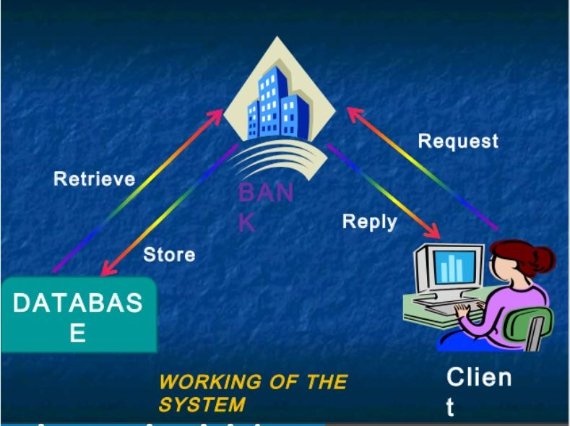
WORKING OVERVIEW

Slide 7
FUNCTIONALITIES
1. CREATING NEW ACCOUNT.
2. UPDATING ACCOUNT.
3. RECOVERY ACCOUNT USING VALIDATING QUESTION.
4. VIEW HISTORY OF TRANSACTIONS.
5. DEPOSITE AND WITHDRAW AMOUNT.
6. CAN TRANSFER MONEY FROM ONE ACCOUNT TO ANOTHER.
7. ALLOW USER TO CHANGE THE ACCOUNT INFORMATION AND SETTINGS IF VERIFIED.

Slide 8
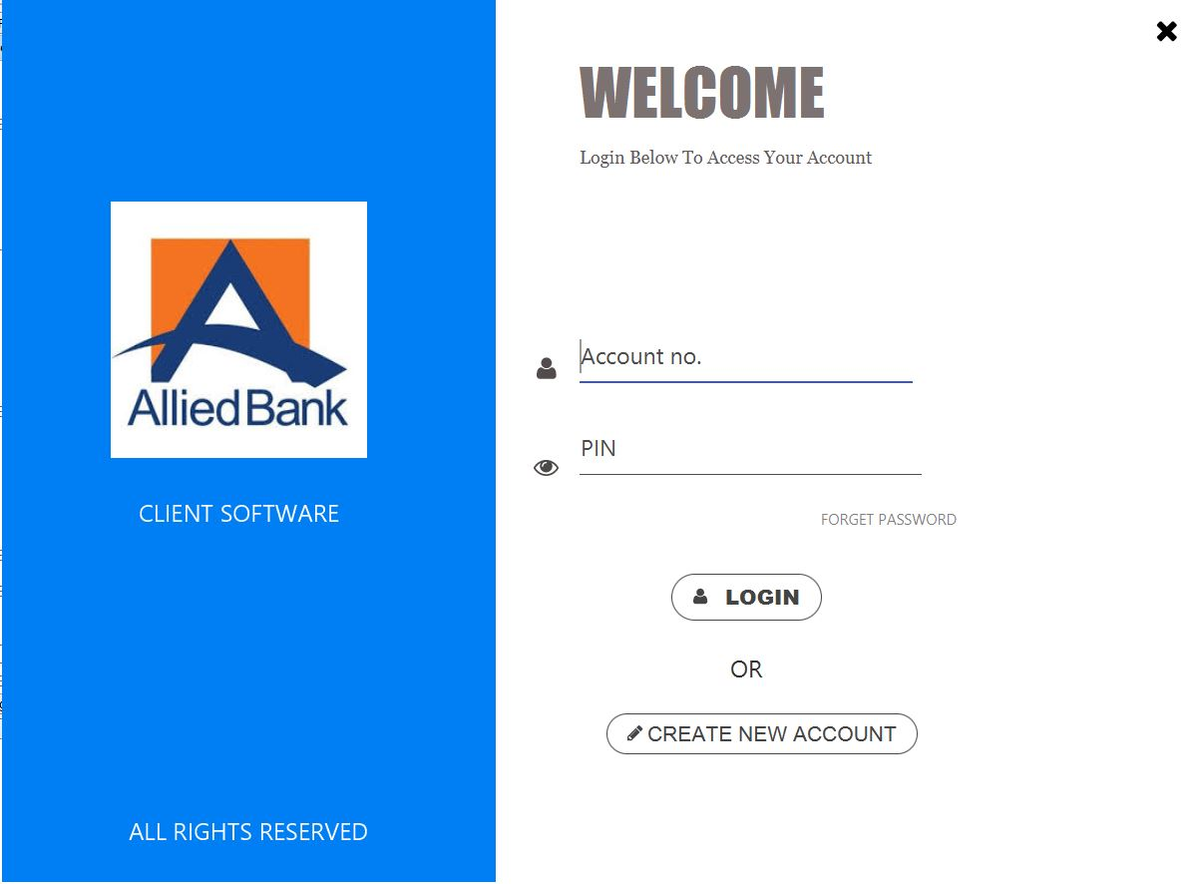
WELCOME SCREEN

Slide 9
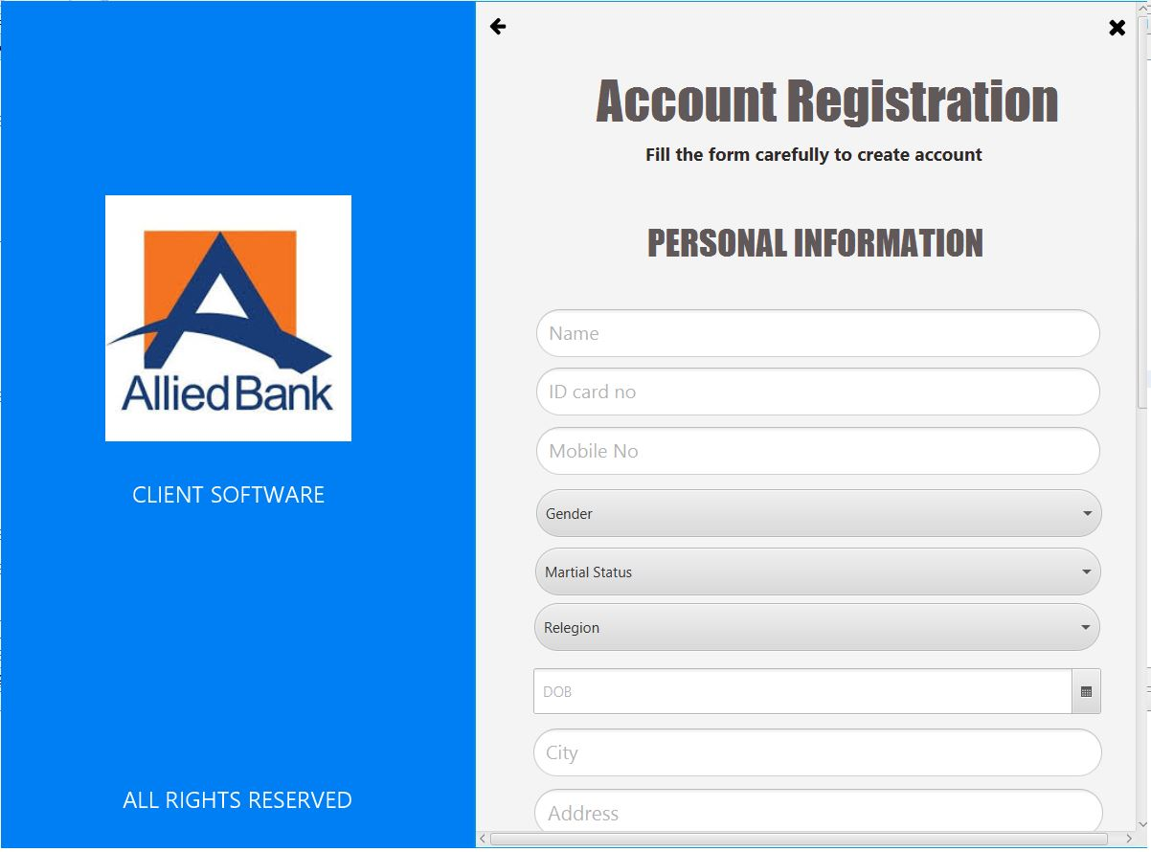
CREATE NEW ACCOUNT (PERSONAL INFO.)

Slide 10
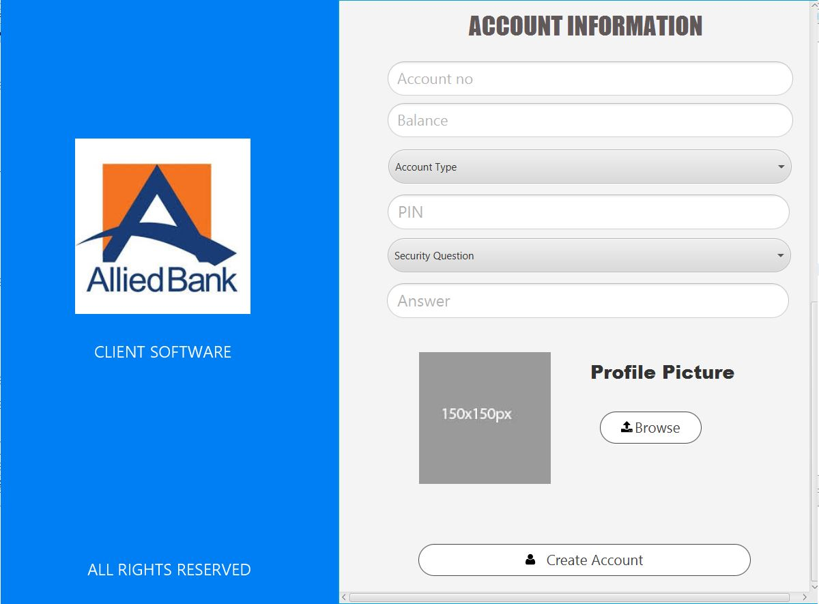
CREATE NEW ACCOUNT (ACCOUNT INFO.)

Slide 11
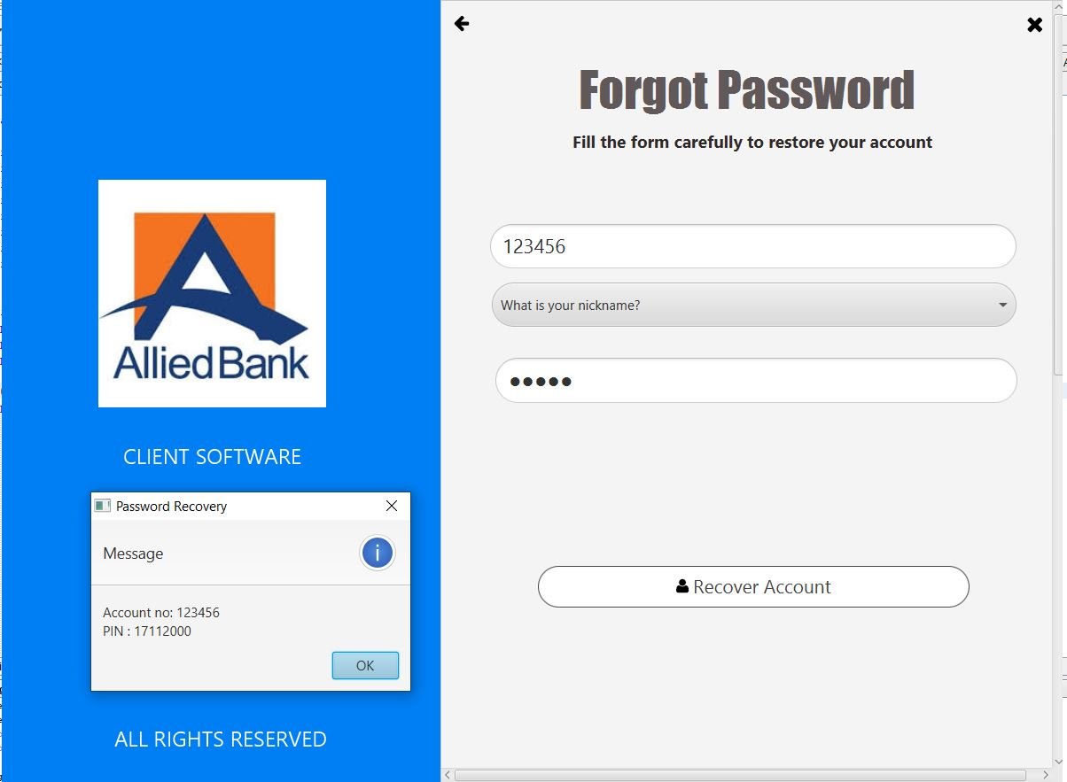
FORGOT PASSWORD

Slide 12
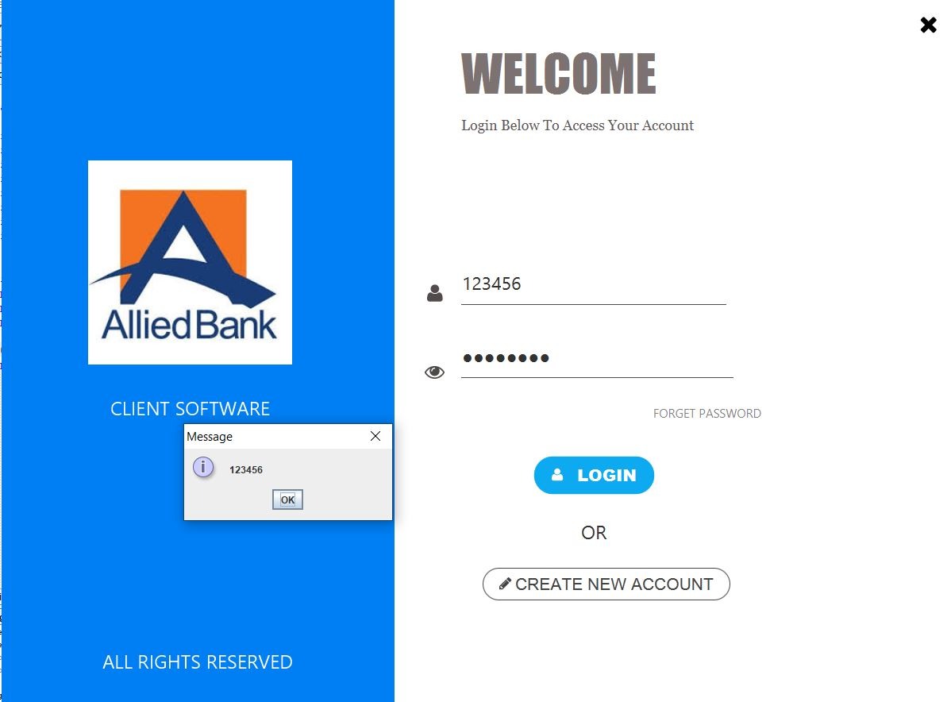
LOGIN SUCCESSFUL

Slide 13
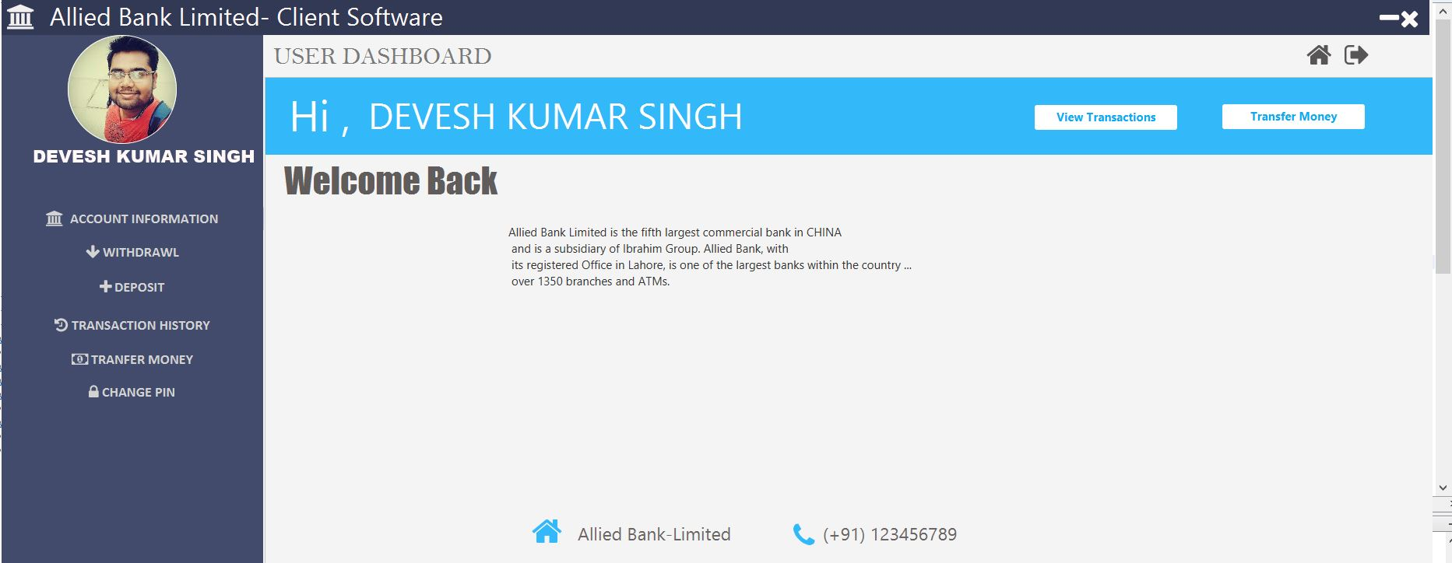
DASHBOARD

Slide 14
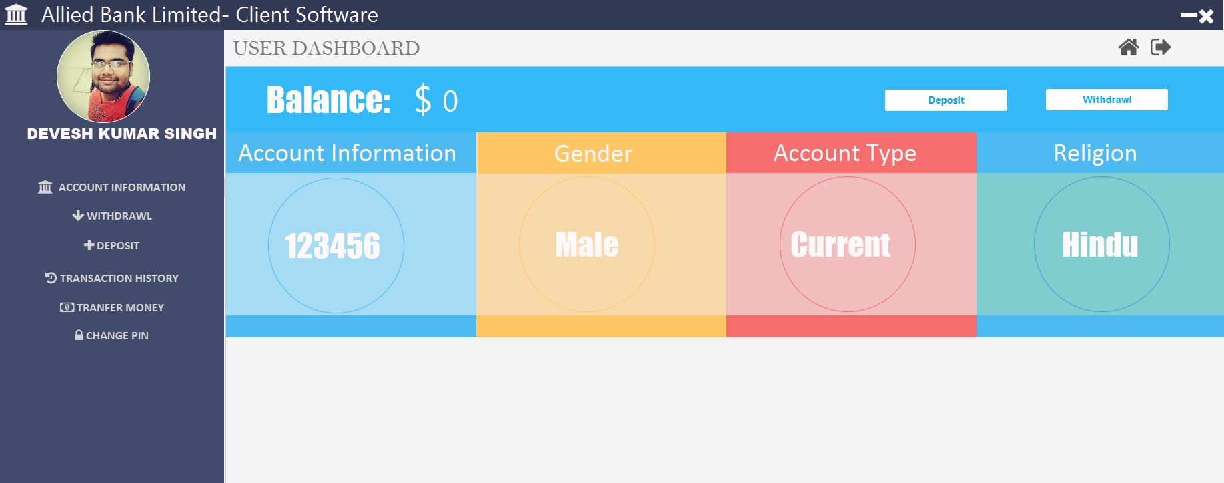
ACCOUNT INFORMATION

Slide 15
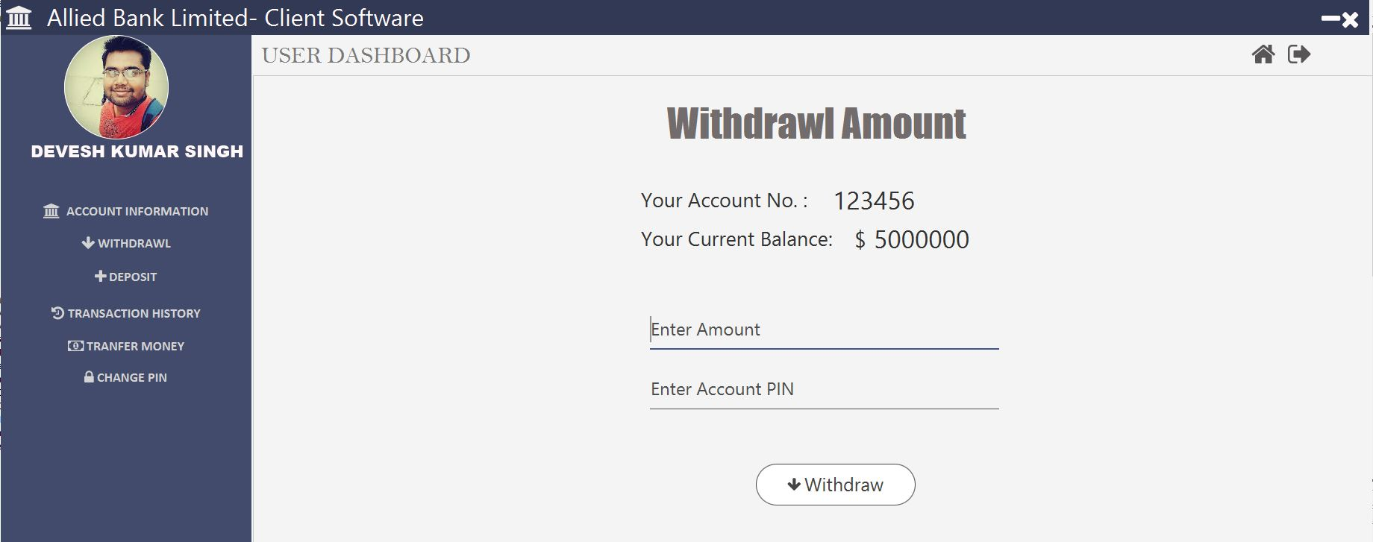
WITHDRAWL (BEFORE)

Slide 16

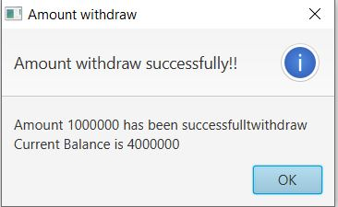
WITHDRAWL (AFTER)

Slide 17
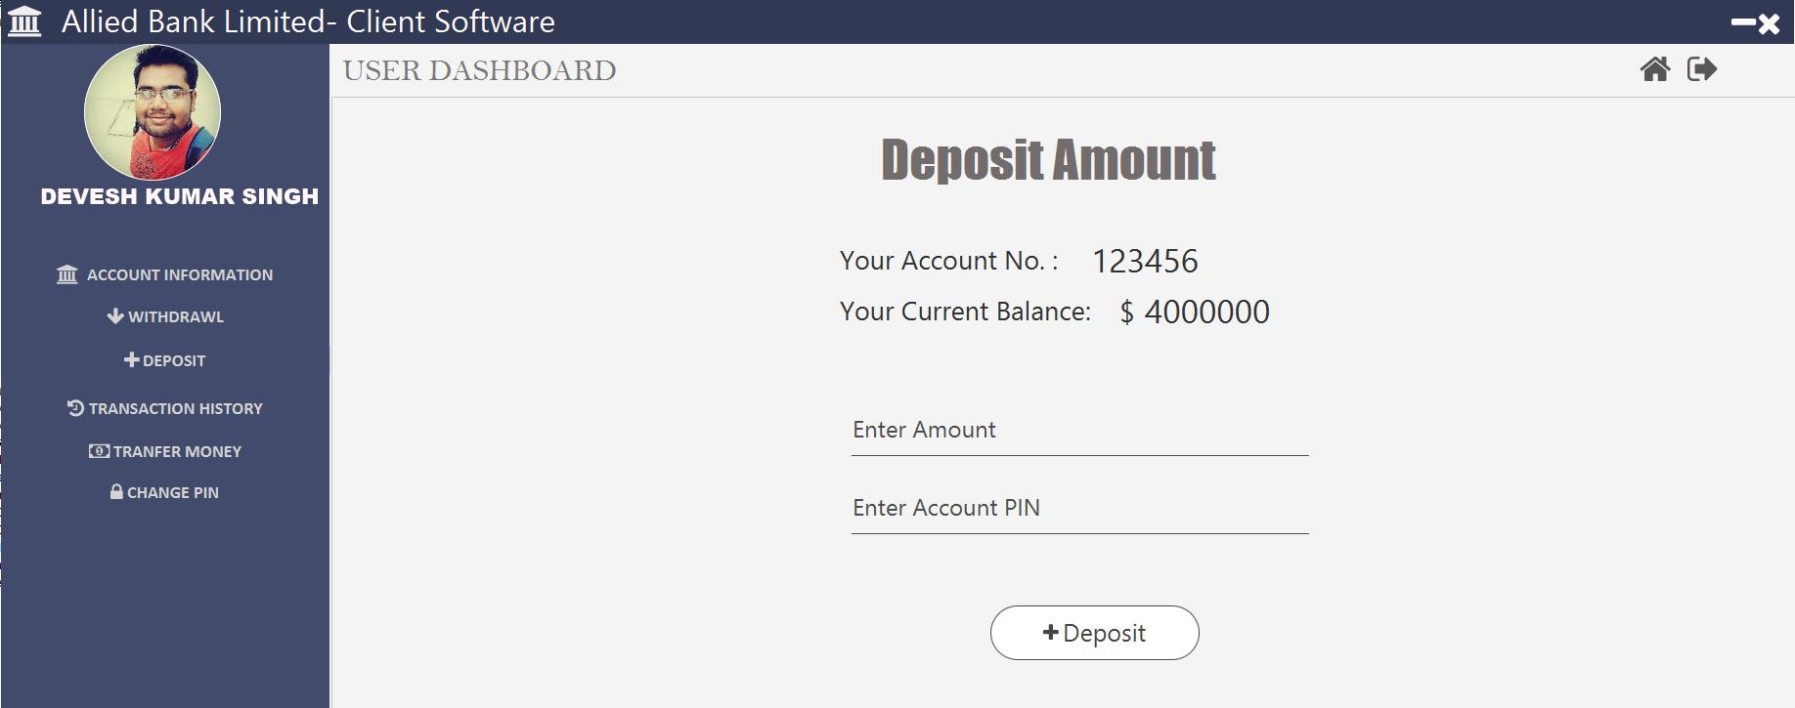
DEPOSITE (BEFORE)

Slide 18

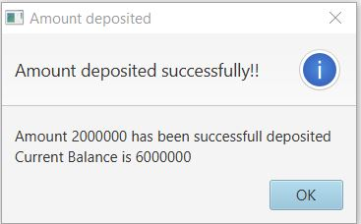
DEPOSITE (AFTER)

Slide 19
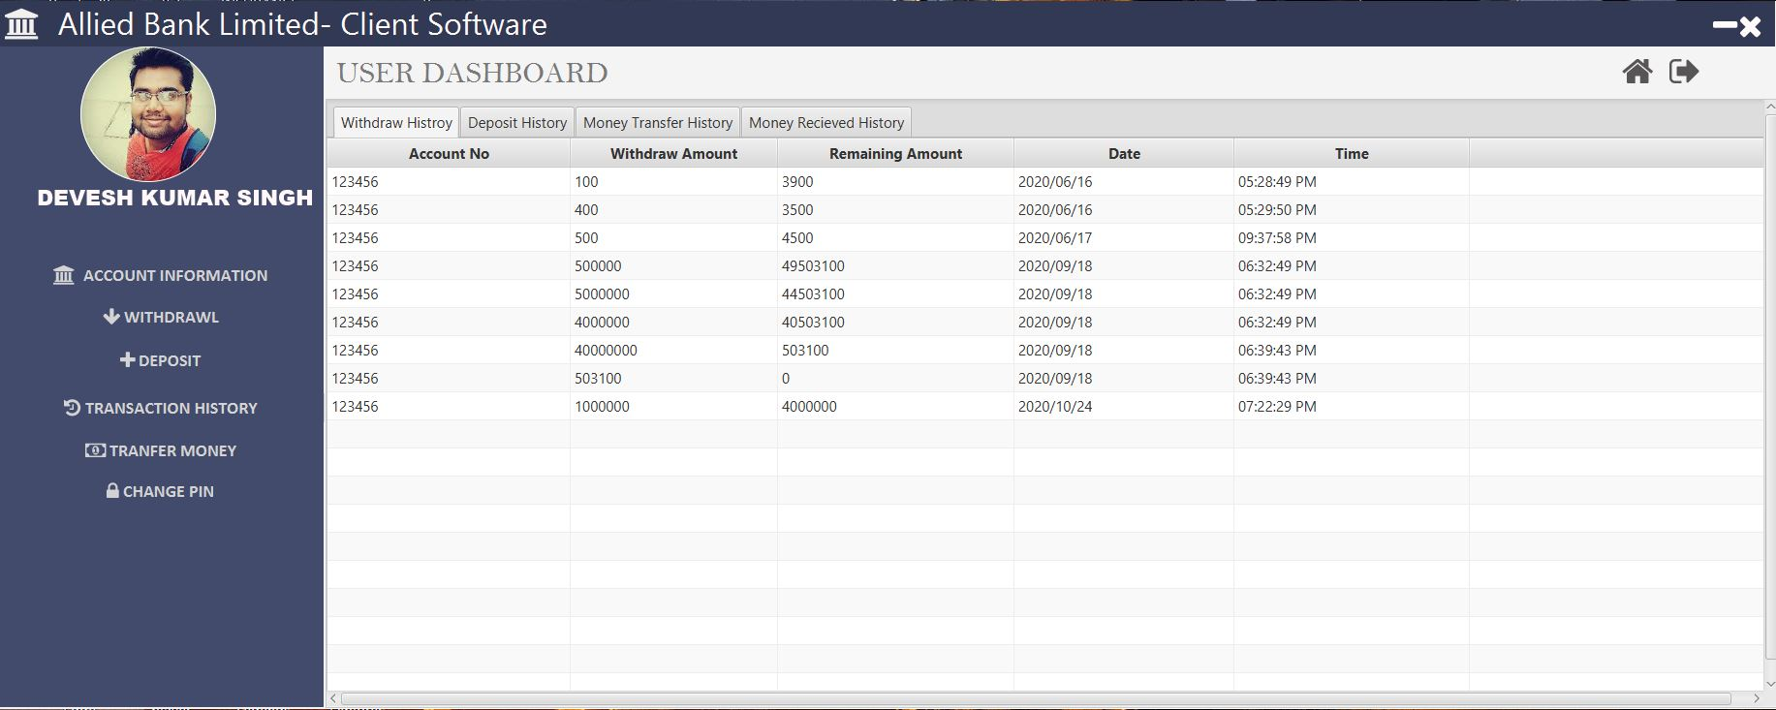
WITHDRAWL HISTORY

Slide 20
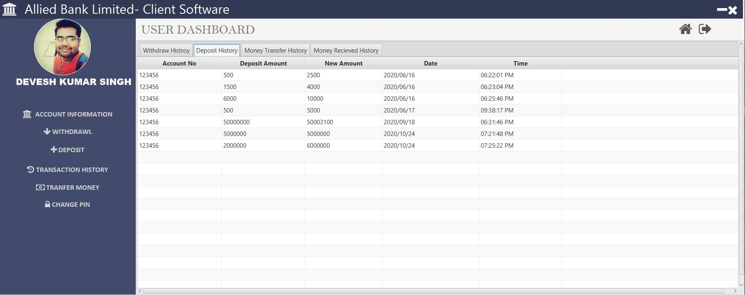
DEPOSITE HISTORY

Slide 21
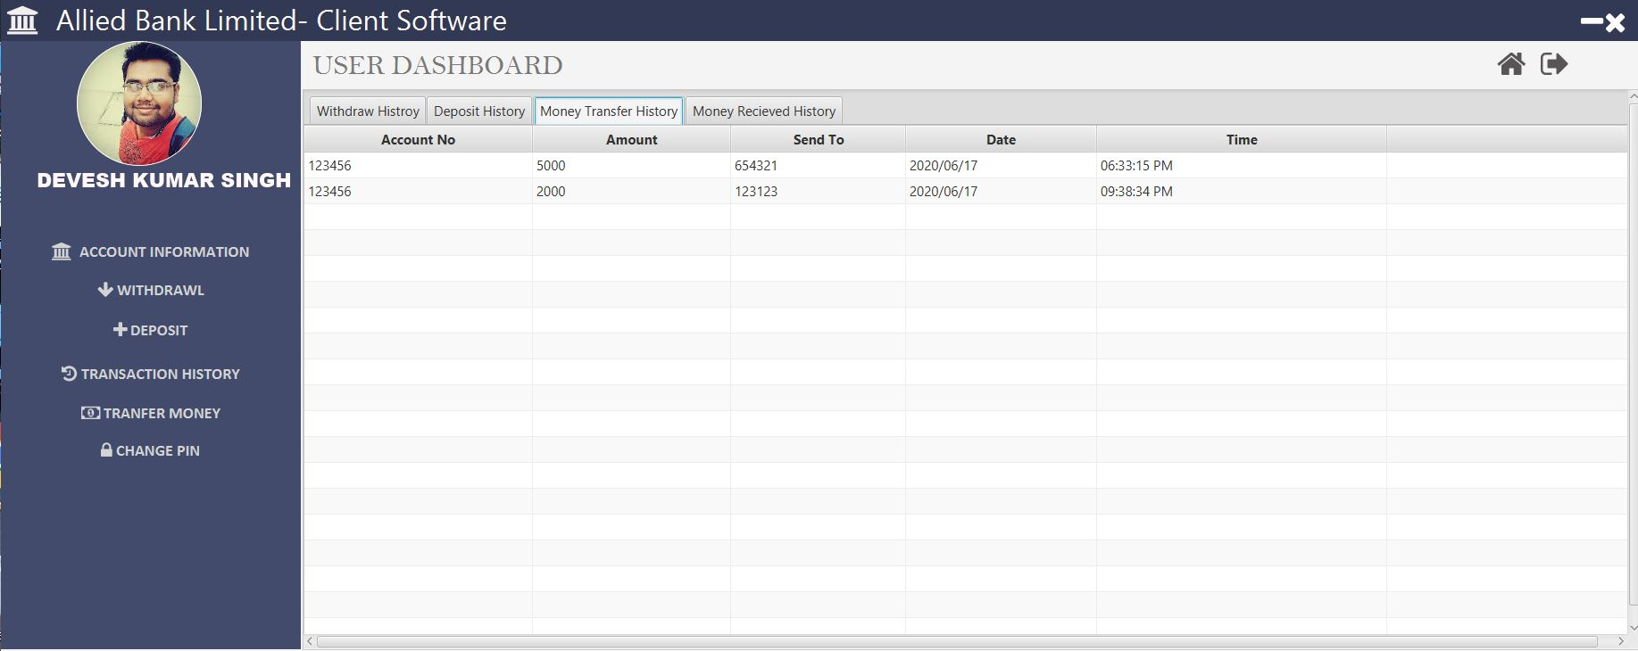
MONEY TRANFER HISTORY

Slide 22
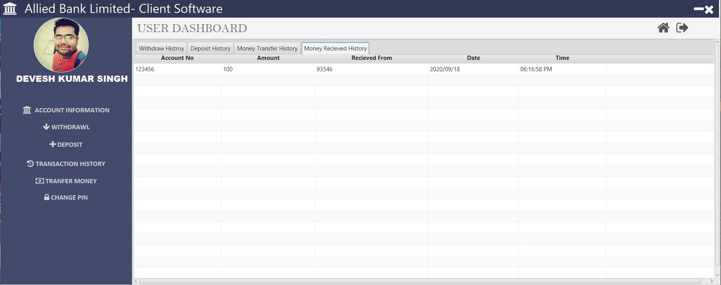
MONEY WITHDRAWL HISTORY

Slide 23
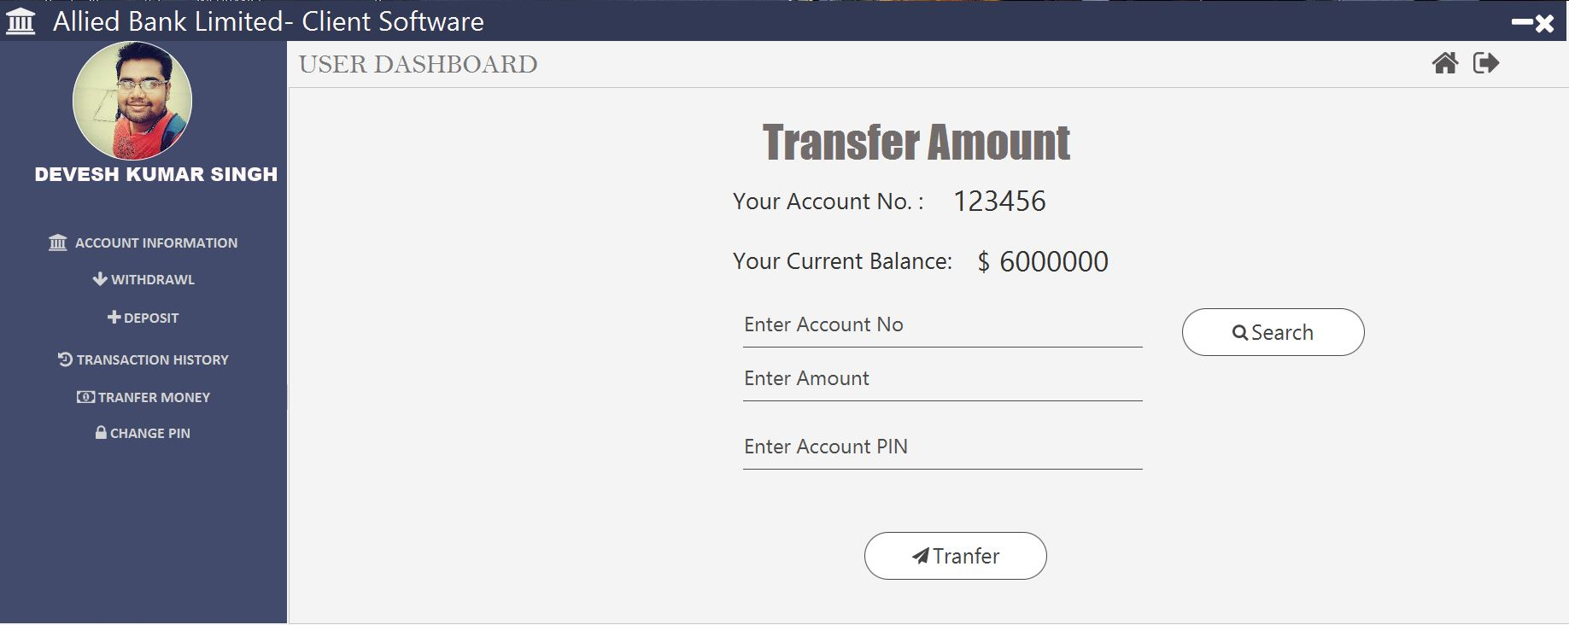
TRANFER MONEY (BEFORE)

Slide 24

VERIFICATIONA OF ACCOUNT FOR MONEY TRANFER

Slide 25
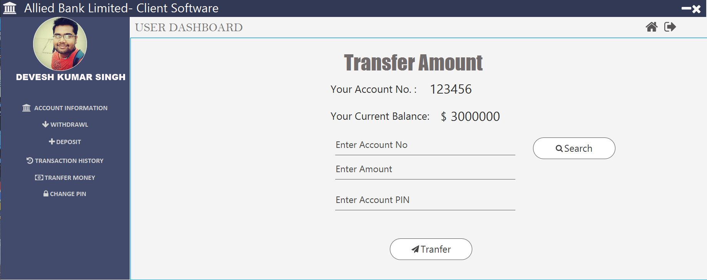
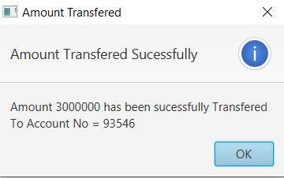
MONEY TRANFER (AFTER)

Slide 26
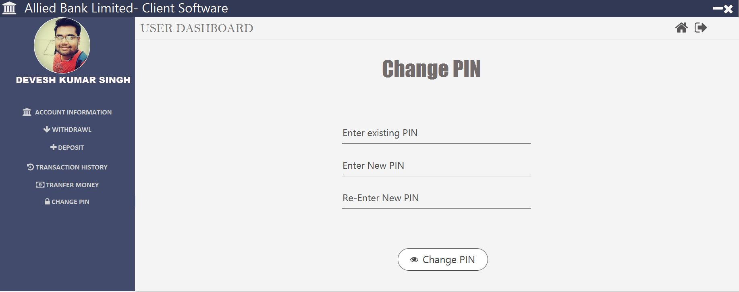
CHANGE PIN

Slide 27
THANK YOU……………….

